Slide 1
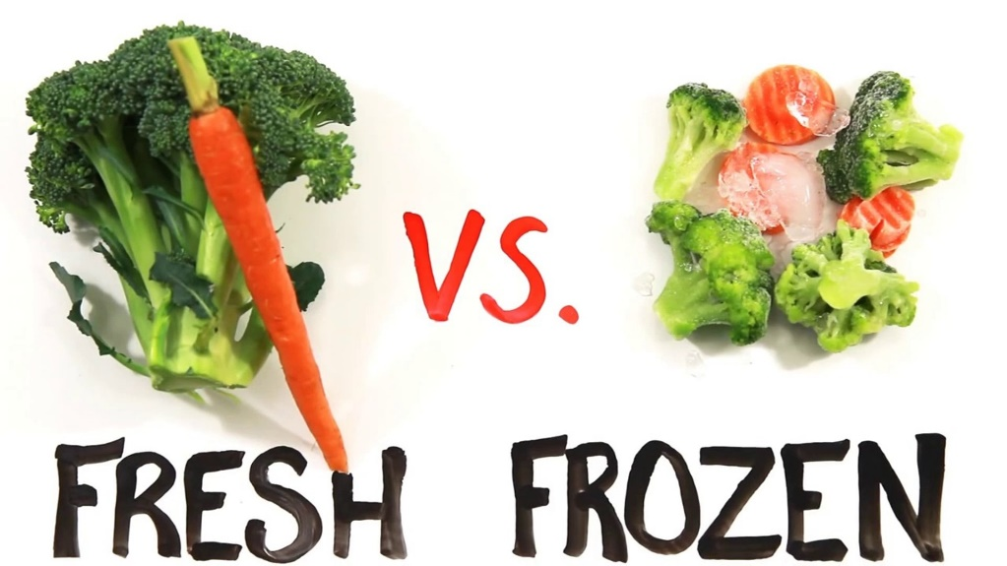
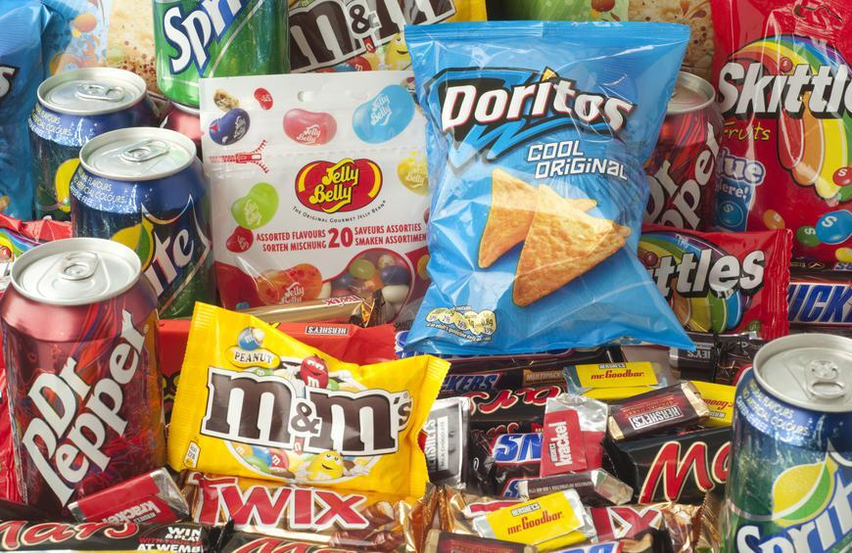
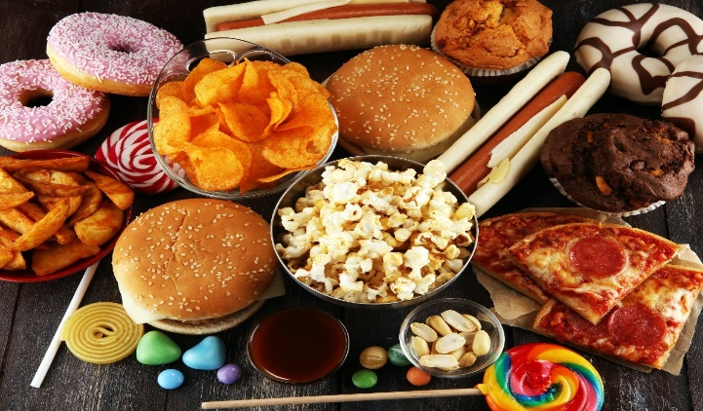
Conversation class
Freezing food
https://youtu.be/UDKyFvBeNzI
Fast
Convenient
Health
Christopher bAUMAN

Slide 2
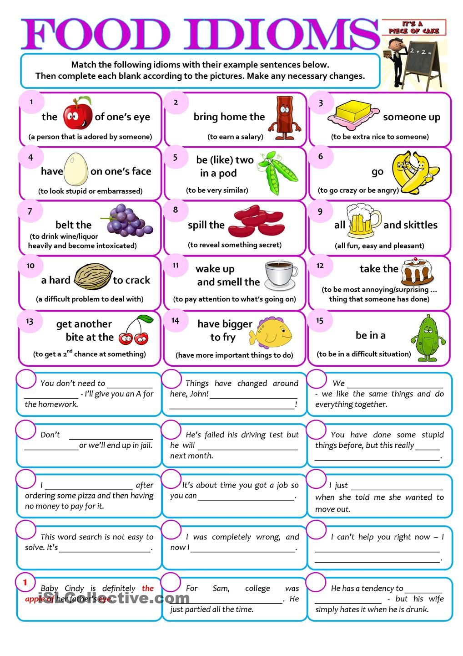
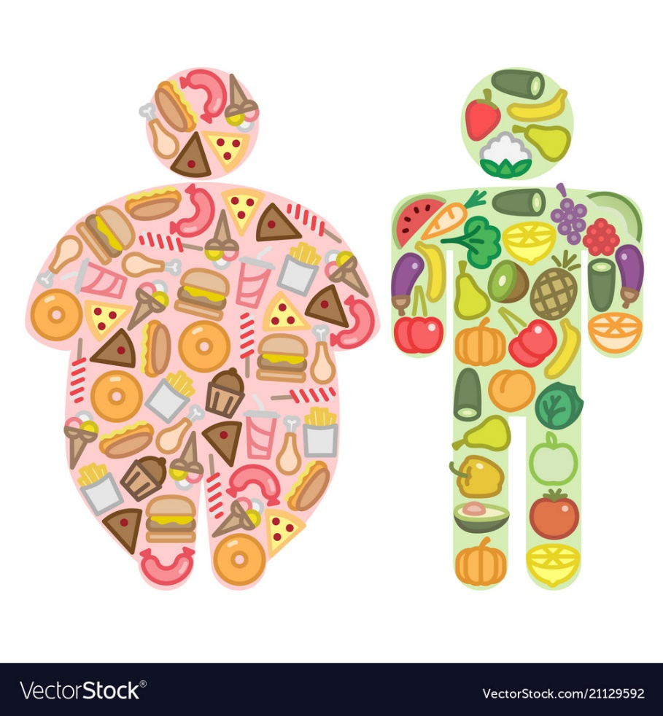
Education Infographic
Teachers
Education
Skills
Chris Bauman

